Slide 1

GEOG 3403: Geographic Information Systems Ⅱ
Lecture 01 Introduction
Yanan Wu, PhD
Assistant Professor
Department of Geography

Slide 2
Overview
Introduction
Who am I?
Who you are?
Course overview and expectations
Syllabus
Software
ArcGIS Pro
What is GIS?
Functions of GIS
GIS components
GIS applications
Careers in GIS

Slide 3
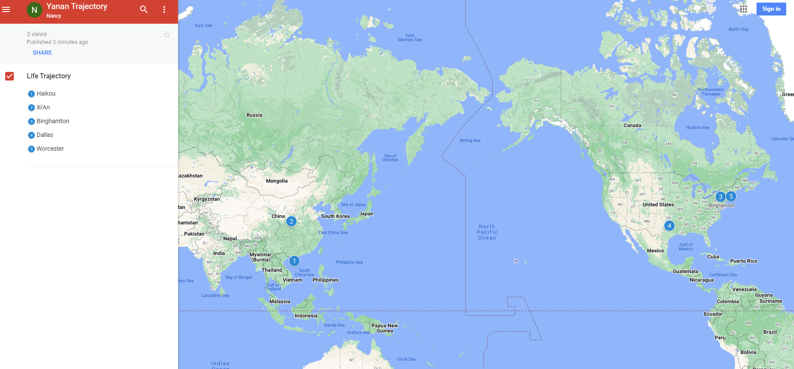
Who am I?

Slide 4


Past Teaching Experience
Python Programming
Spatial Database
Manipulating Spatial Data
Web Mapping
Processing Raster
Data Analysis
Creating Custom Tool
Data Visualization
…
Geodatabase
SQL
Proximity Analysis
Geometry processing
Raster processing
PostSQL with python
…

Slide 5





Past Teaching Experience
Web Mapping
Intermediate Statistics
Bivariate regression
Logistics regression
PCA
GWR
Spatial Autocorrelation
…
HTML
CSS
JS
Python Web Mapping
R Web Mapping
ArcGIS Maps for JavaScript
…

Slide 6

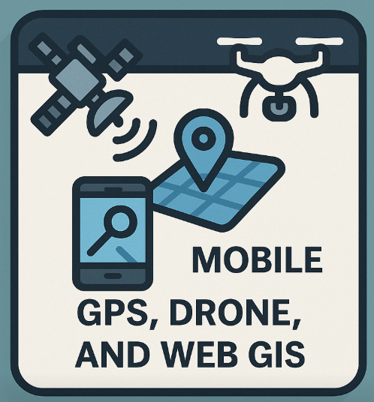
Teaching in UCA
GIS I
Geographic Field Techniques
Spatial Data
GIS software
Geodatabase
Cartography
Raster
Programming in GIS
…
GPS
Drone
Esri Mobile App
Field Map
Survey 123
ArcGIS Dashboard
…

Slide 7
Teaching in UCA
GIS I
Geographic Field Techniques
Spatial Data
GIS software
Geodatabase
Cartography
Raster
Programming in GIS
…
GPS
Drone
Esri Mobile App
Field Map
Survey 123
ArcGIS Dashboard
…

Slide 8
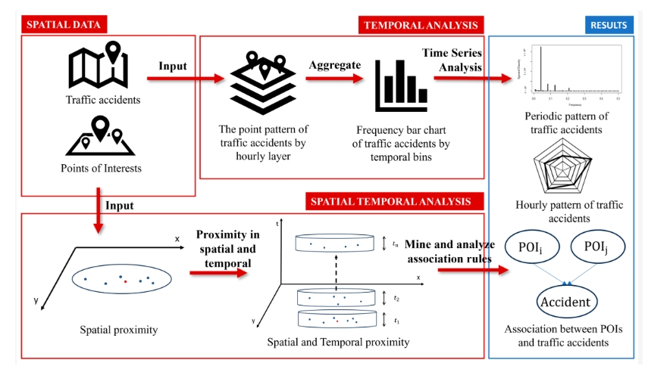
Research
Repetitive Pattern of Traffic Accidents in City of Dallas, TX
Notes:
Southwestern Energy Research Fellow

Slide 9
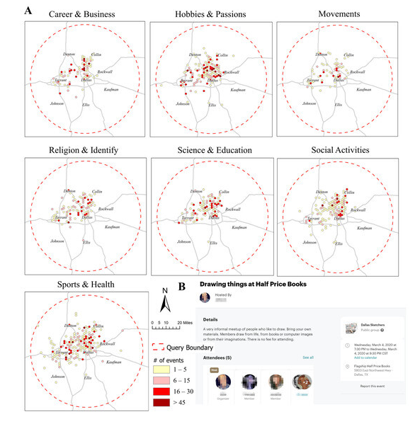
Research
What Local Environments Drive Opportunities for Social Events?
Funded by NASA EPSCoR

Slide 10
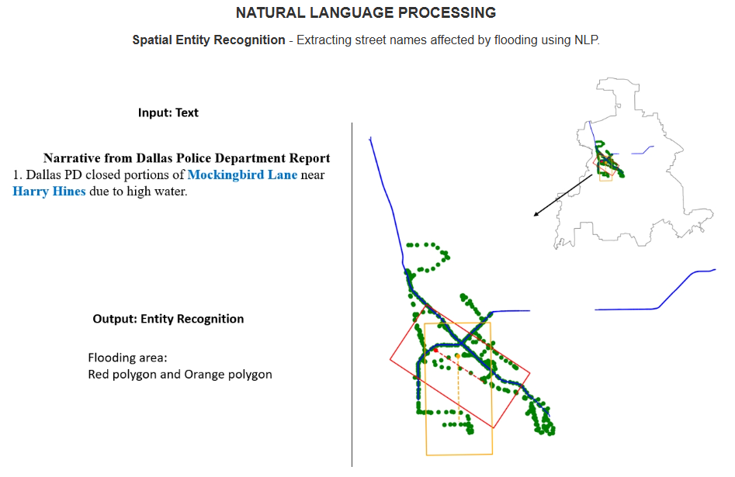
Research

Slide 11
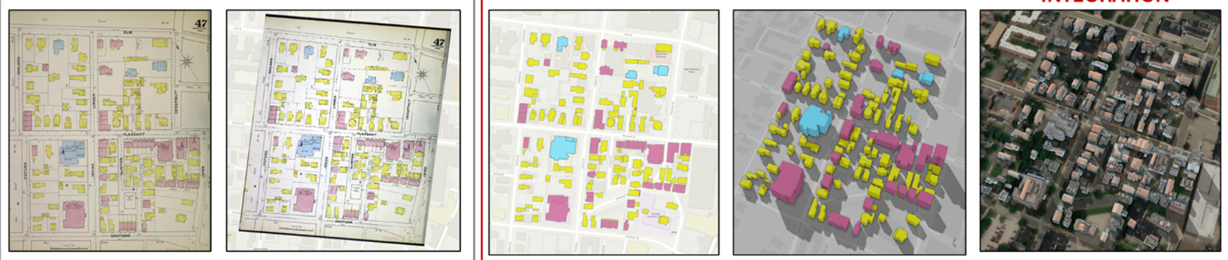
Research
Sanborn Historical Map

Slide 12
About you
Your background (e.g., name, major)
Share something from your winter break
What relevant experience do you have with GIS?
What are your expectations for this course?

Slide 13

Course overview and expectations
Book
GIS Fundamentals by Paul Bolstad (ISBN-10: 978-0971764736; ISBN-13: 0971764735)

Slide 14
Course overview and expectations
Book
Discovering GIS and ArcGIS Pro by Bradley A. Shellito (ISBN-10: 131923075X; ISBN-13: 978-1319230753)

Slide 15
Software
Windows system
Software requirement: Microsoft .NET
Hardware requirement: Geospatial Software Access Geography UCA

Slide 16
Course overview and expectations
Course Structure (4-credit)
Lecture (TR 9:25- 10:40 am)
Interactive and inclusive environment
Feel free at any time during lecture to ask a question and make a comment
Lecture will be recorded and delivered to the students if necessary
Lab exercise (R: 10:50- 1:05 pm)
Work individually on the in-class exercise
Guidance will be provided; demonstration will be provided if necessary
When submit exercise, copy questions in the lab and provide answers in a word file
Feel free at any time to ask a question

Slide 17
Course overview and expectations
Course Structure
Quiz 1 & 2: 100 points in total
Quiz 1 (W7: Feb 15 - 20): 50 points
Quiz 2 (W15: Apr 6 - 10): 50 points
Final project: 400 points in total
For 4-credit version of this course only
Design your own research, get your own data, process the data, generate maps, and write a final report
You can refer to the previous exercise to get help
Lab exercise: 500 points in total

Slide 18
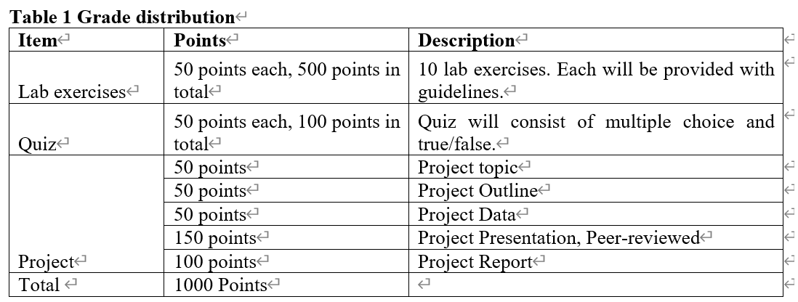
Course overview and expectations
Grading
4-credit version
Labs that are not turned in by the due date can be turned in up to 2 days late with a 20% penalty. Labs will not be accepted after this 2-day period.

Slide 19
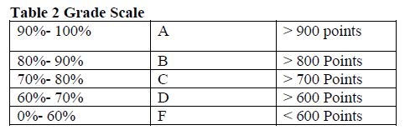
Course overview and expectations
Grading
4-credit version

Slide 20
Course Schedule
Feb 16 – 20
Quiz 1
Mar 9-13
Project Discussion
Mar 16-20
AAG Conference
Mar 23-27
Spring Break
Apr 6 – 10
Quiz 2
Apr 13 - 17
Project analysis
Apr 20 - 24
Final Project Presentation
Apr 27 – May 1
Final Project Report

Slide 21
Course overview and expectations
Late penalty for lab
Labs that are not turned in by the due date can be turned in up to 2 days late with a 20% penalty. Labs will not be accepted after this 2-day period.
Final presentation
The final presentation cannot be rescheduled. You are expected to do the final presentation at the time specified.

Slide 22
Course overview and expectations
Attendance
Prolonged absence from class will inhibit your understanding of the lecture material and prevent you from receiving help on assignments
We may do some bonus exercises during the class time. If you are not shown up, you simply lose it
Up to 3 times of absence may result in moving out from this class
If you cannot attend class, please contact me before class
Sick leave is acceptable, please contact me for re-arranging lab exercise etc.

Slide 23
Course overview and expectations
Feedback Response Time
The instructor generally replies to emails within 48 hours, except during holidays.
Often the instructor replies much more quickly, but you should not count on a same-day reply.
Please plan accordingly so that you don’t miss deadlines.

Slide 24
Course overview and expectations
Classroom Etiquette
Switch cell phones off and place them out of view. Do not use phones during class. Resist the impulse!
Computers are permitted for notetaking only.
Do not sleep in class or leave once a lecture has started.
Do not pack up and prepare to leave until the instructor has indicated that class is over
No eCigarettes permitted in the classroom.
You are encouraged to think critically and ask stimulating questions, but always respect your fellow students and your instructor.

Slide 25
Course overview and expectations
Evaluations
Student evaluations of a course and its professor are a crucial element in helping faculty achieve excellence in the classroom and the institution in demonstrating that students are gaining knowledge.
Students will receive evaluation notification from university.

Slide 26
Course overview and expectations
Structure
In-person
Lecture
Lab
Quiz (delivery through Blackboard)
Office hour
MW 10:00 am to 11:45 am
Location: BurdicK Hall 318B
May Change!
Please regularly check your Blackboard and or email

Slide 27
Course overview and expectations
After this course
explain concepts and principles of various spatial analysis methods
work with a variety of raster datasets
perform sophisticated raster and vector analysis
perform network, terrain, hydrological, GWR, land cover and land use change analyses, and time-series
conduct and interpret spatial statistical results
produce spatial models using ArcGIS Model Builder
use the ArcGIS software package with a variety of data and methods to address a question with a spatial component

Slide 28
Course overview and expectations
Contact Info
Burdick 318B
Office Hour:
MW 10:00-11:45 am
Email: ywu@uca.edu

Slide 29
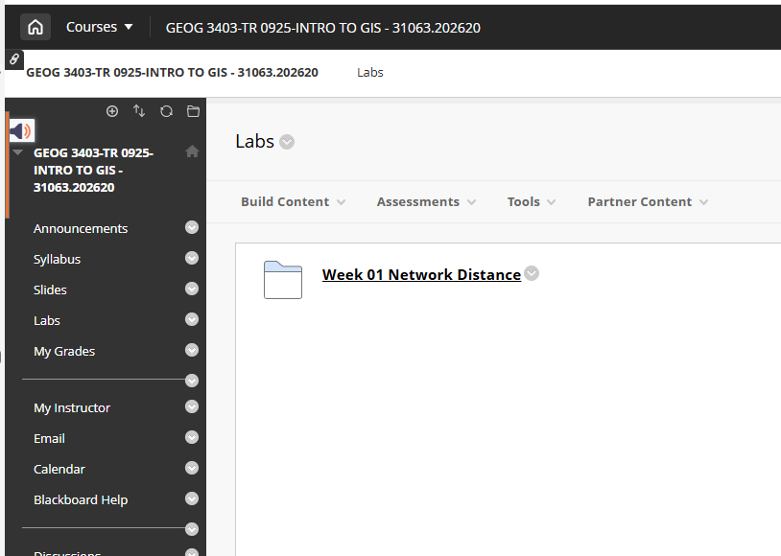
Course overview and expectations
Place for slides, and submitting lab exercise

Slide 30
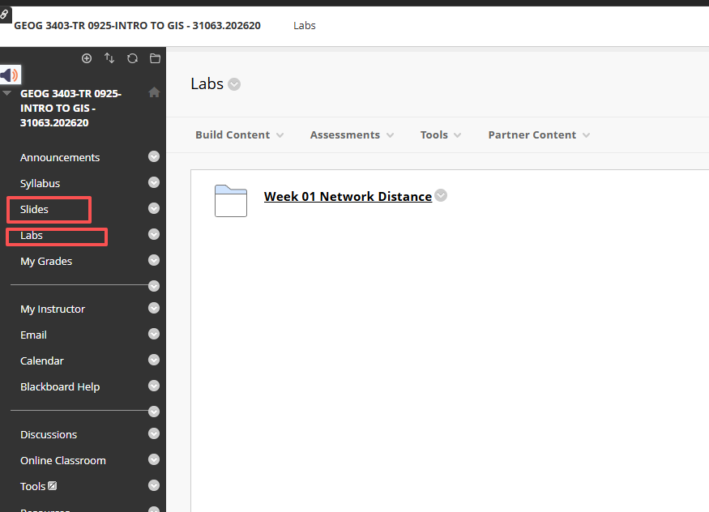
Course overview and expectations
Place for slides, and submitting lab exercise

Slide 31
ESRI https://pro.arcgis.com/en/pro-app/latest/get-started/run-pro-on-a-mac.htm Harvard https://gis.harvard.edu/faq/how-installing-arcgis-desktop-or-pro-mac-computer
Software
ArcGIS Pro installed on Mac/other computer
Mac
Other PCs (e.g., Chromebook, Microsoft surface)
Please talk with/email to me

Slide 32
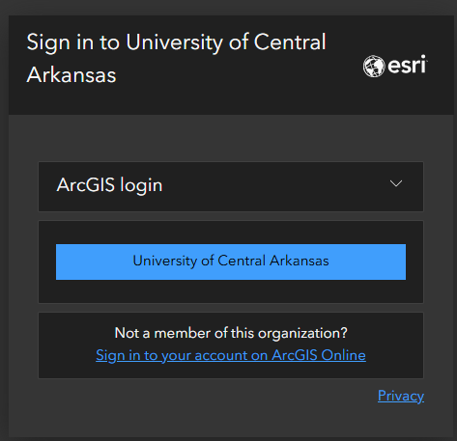
Software – ArcGIS Online
ArcGIS Online
Log in ArcGIS online
https://uca.edu/geography/gis/

Slide 33

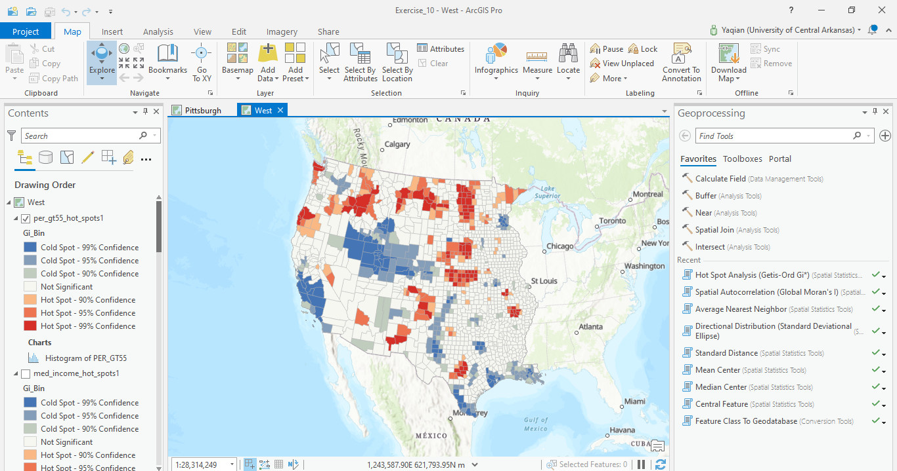
Software – ArcGIS Pro
ESRI ArcGIS Pro

Slide 34
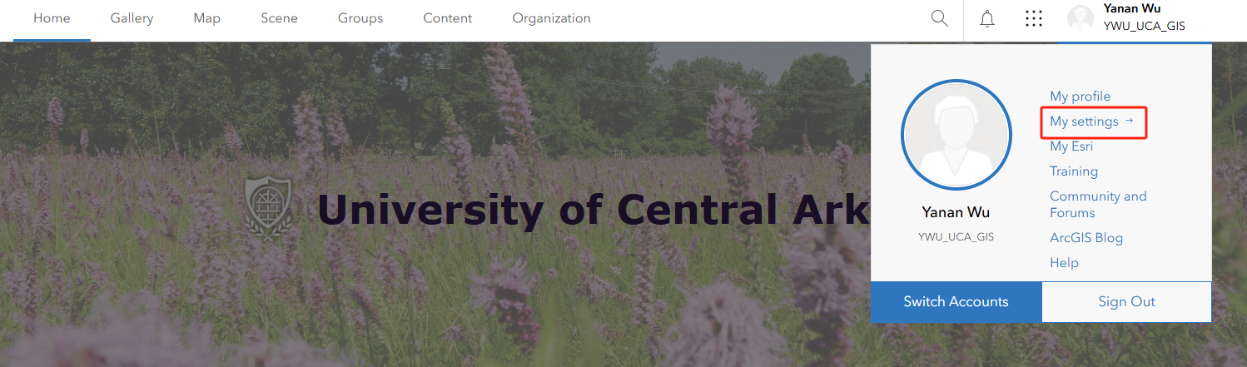
Software
ArcGIS Pro installed in your own PC

Slide 35
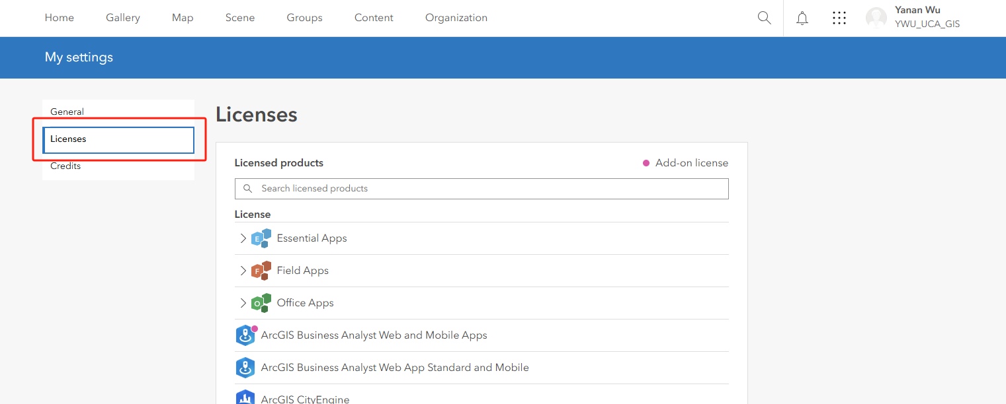
Software
ArcGIS Pro installed in your own PC

Slide 36
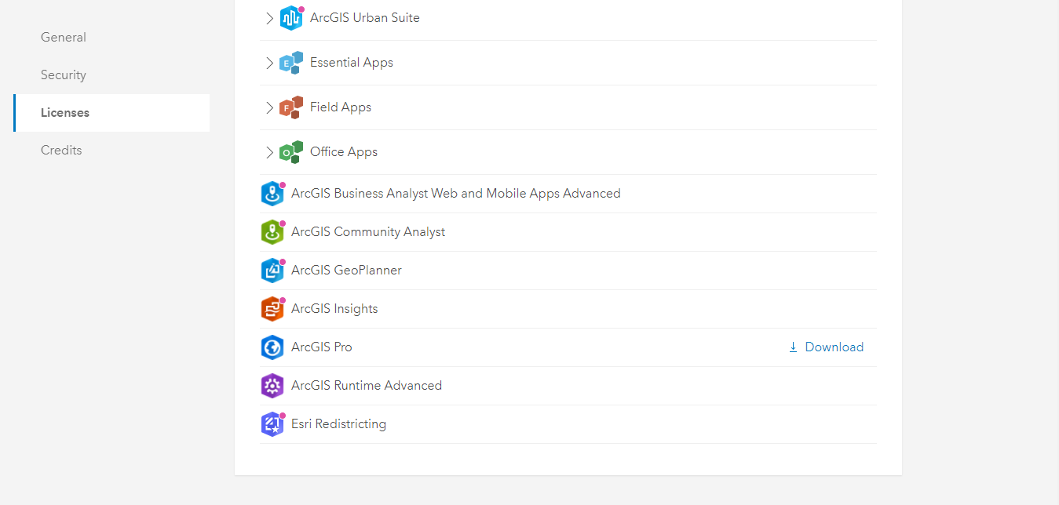
Software
ArcGIS Pro installed in your own PC

Slide 37
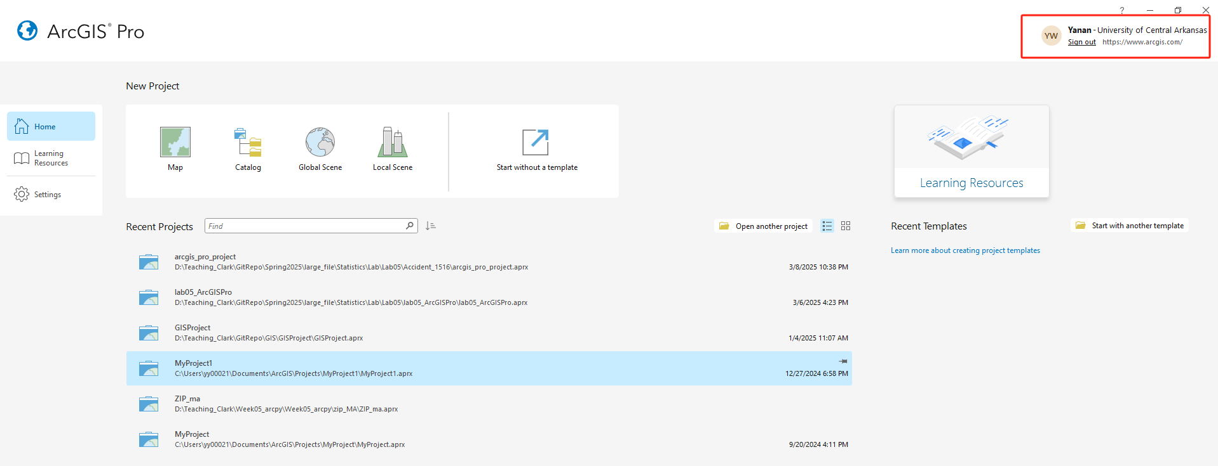
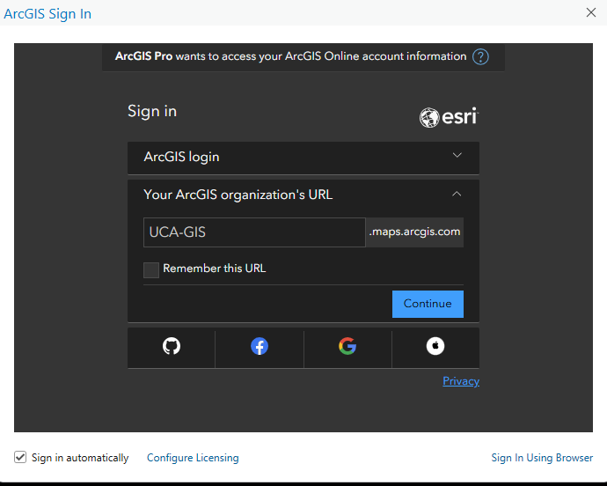
ArcGIS online account
ArcGIS Pro

Slide 38
GIS Application in Modern World

Slide 39

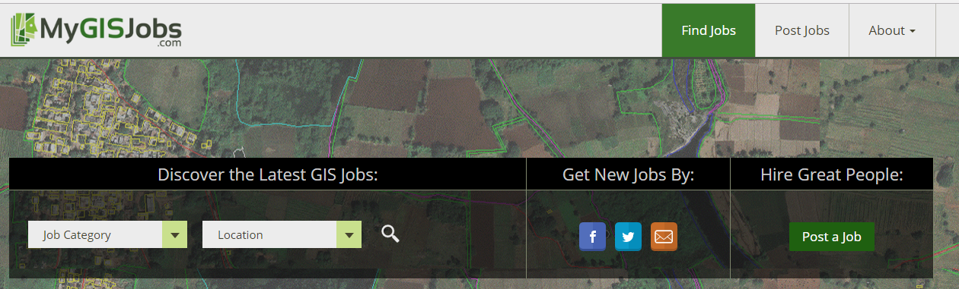

GISer Job Market
Local Government
Planning and environmental management
property records and appraisal
Real Estate and Marketing
Retail site selection, site evaluation
Public safety and defense
Crime analysis, fire prevention, emergency management, military/defense
Natural resource exploration/extraction
Petroleum, minerals, quarrying
Transportation
Airline route planning, transportation planning/modeling
Public health and epidemiology
The Geospatial Industry
Data development, application development, programming
https://www.gisjobs.com/
https://www.mygisjobs.com/
http://www.gjc.org/
Notes:
With this wide application, people with GIS specialty has lots of opportunities for their career.
I would recommend the GIS Jobs website if you are interested in searching for geospatial career opportunities: http://www.gjc.org/.

Slide 40


Geography Students placement @UCA
2020-2021
Four students worked as full time at ARDOT
Three students in master GIS program @UCA (One student is supported by Arkansas Space Grant Consortium project)
2022
Two current students worked as part-time at ARDOT

Slide 41

Geospatial Skillsets
Spatial problem solving
Spatial analysis
Software troubleshooting
Statistics
Spatial predictive modeling
Database management
Web GIS
Python scripting
Cartography/Map design
Graphic design
Image interpretation
GPS tracking
http://www.aag.org/cs/publications/special/gist
Notes:
These are the important geospatial skillsets for geospatial professionals. After this course, you will get some of this abilities. To get more advanced understanding and skillsets, I highly recommend to take advanced GIS and Cartography courses.
Since GIS is a fast growing field that relies heavily on technology. You will need to continue to develop your skillset throughout your professional career and you can check the professional associations.

Slide 42

Esri Summer Intership
Notes:
These are the important geospatial skillsets for geospatial professionals. After this course, you will get some of this abilities. To get more advanced understanding and skillsets, I highly recommend to take advanced GIS and Cartography courses.
Since GIS is a fast growing field that relies heavily on technology. You will need to continue to develop your skillset throughout your professional career and you can check the professional associations.

Slide 43
Thank you!

